Slide 1
Quantum vs Classical Portfolio Optimization
By: Om Tailor

Slide 2
Problem Overview
Goal: Find the minimum variance portfolio using both classical and quantum methods.
Application: Financial asset allocation (e.g., JNJ and TSLA).
Constraint: Sum of weights = 1 (no target return).
Motivation: Test VQLS as a near-term quantum method to solve optimization problems.

Slide 3
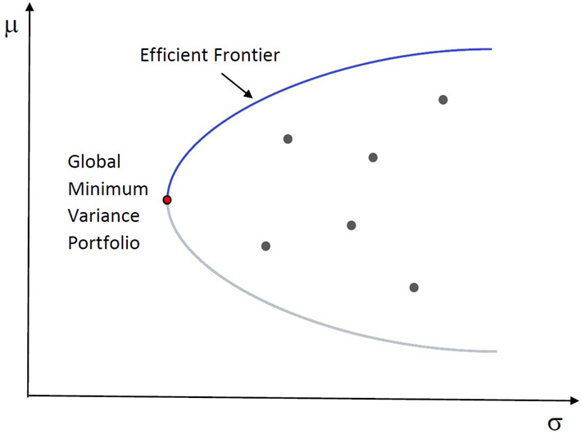
Classical Method
Approach:
Uses scipy.optimize.minimize with SLSQP
Objective: Minimize w.T @ Σ @ w
Constraint: sum(w) = 1
Output:
Asset weights
Portfolio variance
Sharpe ratio

Slide 4
Quantum Method (VQLS)
Framework: Pennylane (default.qubit)
Steps:
Prepare matrix A and vector b from Σ and constraints
Initialize with a warm-start state from classical weights
Optimize with Adam, using a custom cost function
Output:
Quantum state amplitudes → asset weights
Quantum portfolio variance, return, and Sharpe ratio

Slide 5
Ansatz
Component | Implementation | Purpose
Warm-start | MottonenStatePreparation(initial_state) | Initializes to minimization problem
Parametric Gates | RY​(θ) rotations | Tunable single-qubit parameters for flexibility
Entanglement Layer | CNOTs between adjacent qubits | Adds expressivity to capture correlations
Symmetric Layout | R_Y​ → CNOT → R_Y | Balance for stable convergence
Shallow Circuit | 2–3 layers total | NISQ-friendly (minimize depth & decoherence)

Slide 6
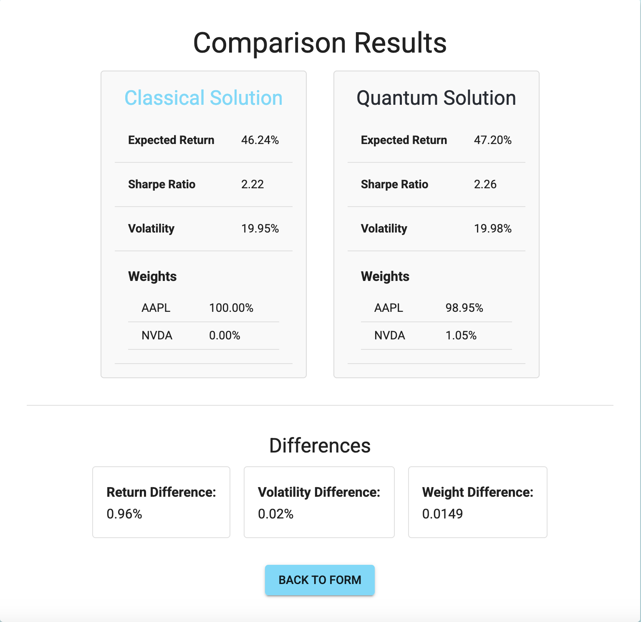
Performance Evaluation

Slide 7
Resource Requirements
Classical:
Standard CPU
Fast and scalable to hundreds of assets
Quantum (benefit is for larger sizes which are difficult to simulate):
Uses 2^n states → logarithmic qubit count
Example:
2 assets → 4×4 matrix → 2 qubits
8 assets → needs 3 qubits

Slide 8
Scalability
Quantum:
VQLS is variational, suitable for NISQ hardware
Scalability limited by ansatz expressibility & gradient noise
Classical:
Easily scales to hundreds of assets

Slide 9
Conclusion
Quantum method shows comparable accuracy for small portfolios
Warm-start and target penalty improve convergence
Classical method still dominates in scalability until the creation of better quantum devices

